Slide 1

QuestionnAIre
Core Features:
Automated patient history taking with predefined question catalogs
AI-powered answer evaluation and intelligent follow-up questions
Structured medical summaries
User-friendly chat interface
Target Audience: Medical professionals, clinics, practices

Slide 2
Goal - Why QuestionnAIre?
The Problem with Traditional Medical History Taking
Why not a simple form?
Problems with static forms:
Challenges:
Patients often don't understand questions correctly
Time constraints
Follow-up questions and reformulations are necessary
Completeness: No questions can be skipped
No summary possible
Red Flags: Warning signs for dangerous conditions must be identified
Example:
Doctor: "How much do you smoke?"
Patient: "A little bit."
Doctor: "How many cigarettes per day?"
Patient: "30 per day."
Solution: Intelligent chatbot with AI-powered follow-up logic

Slide 3

Tech Stack
Frontend:
HTML5, JavaScript (Vanilla)
Tailwind CSS for modern design
Backend:
Python with FastAPI
LangGraph for workflow management
LLM Models:
OpenAI GPT-4o (Primary model for the Prototype)
Hugging Face Transformers (Alternative)
Ollama (Local models)
Development Tools:
Cursor
Claude Sonnet 4 and Gemini 2.5 Pro as development assistants

Slide 4
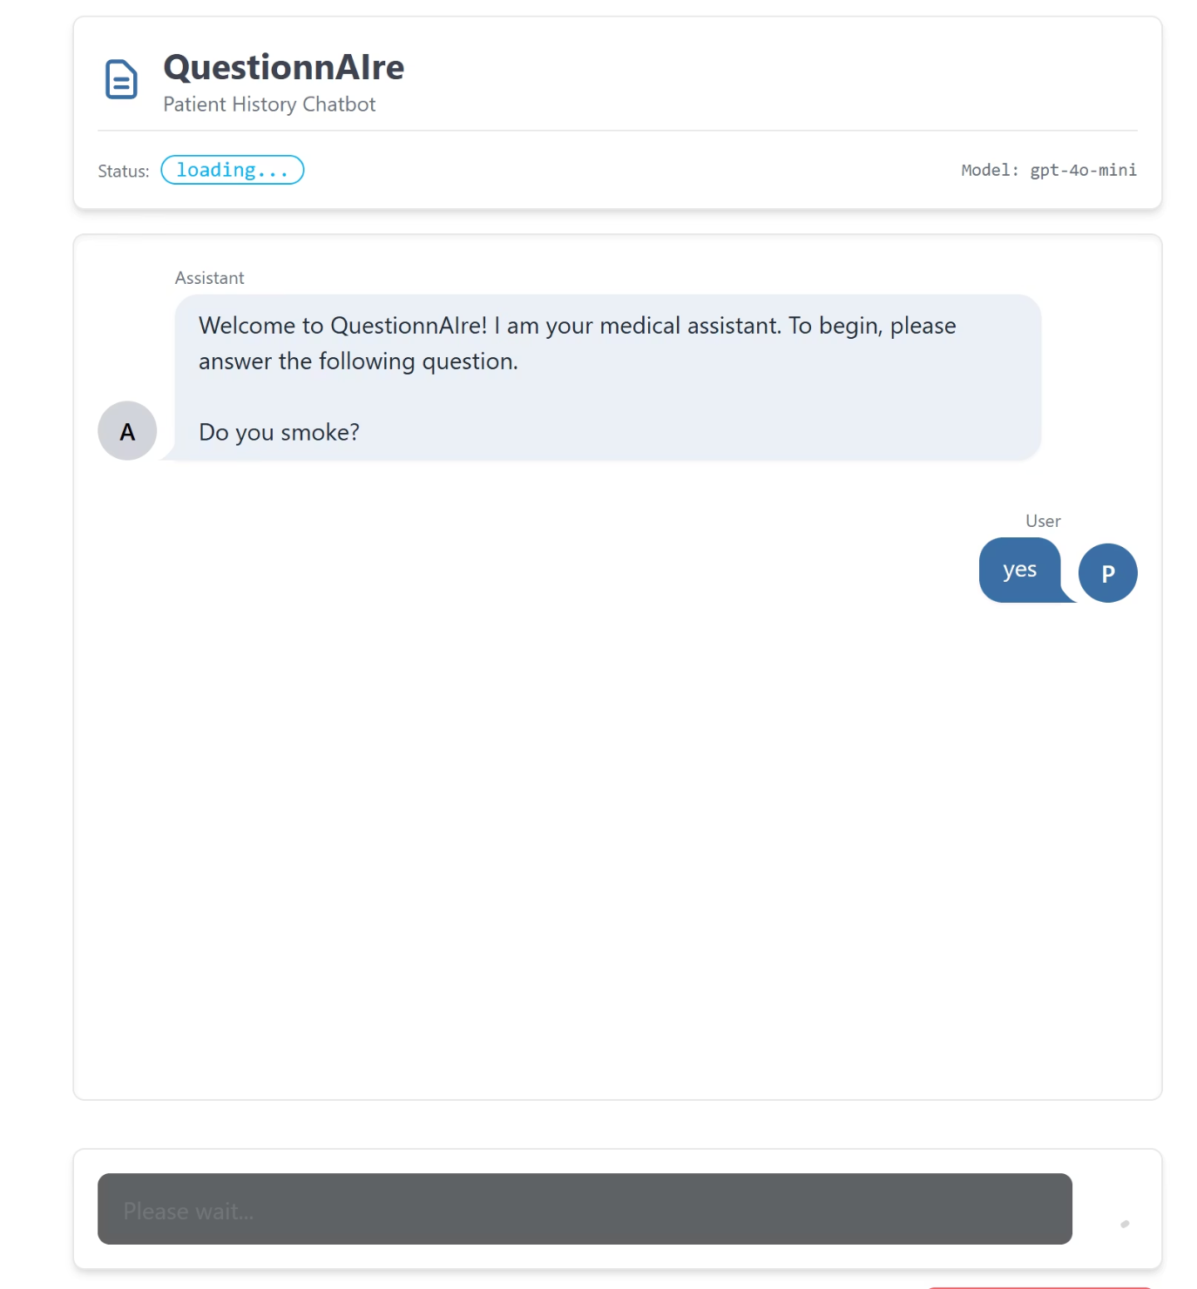
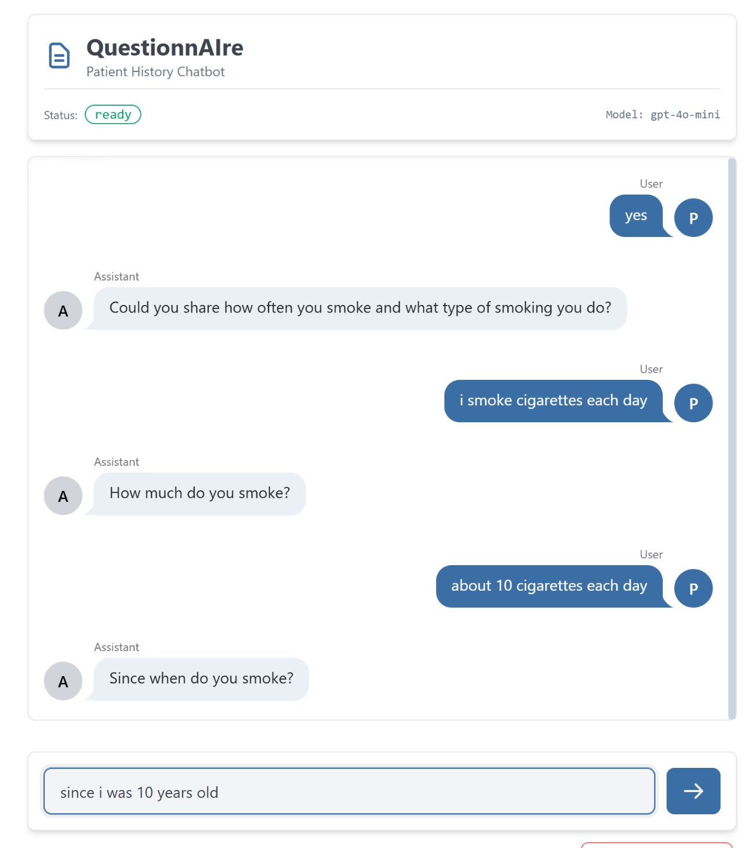
User Interface

Slide 5
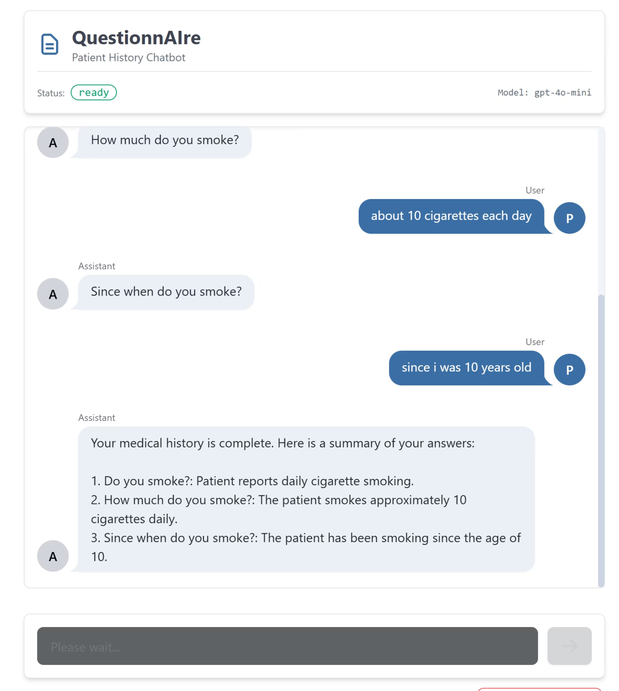
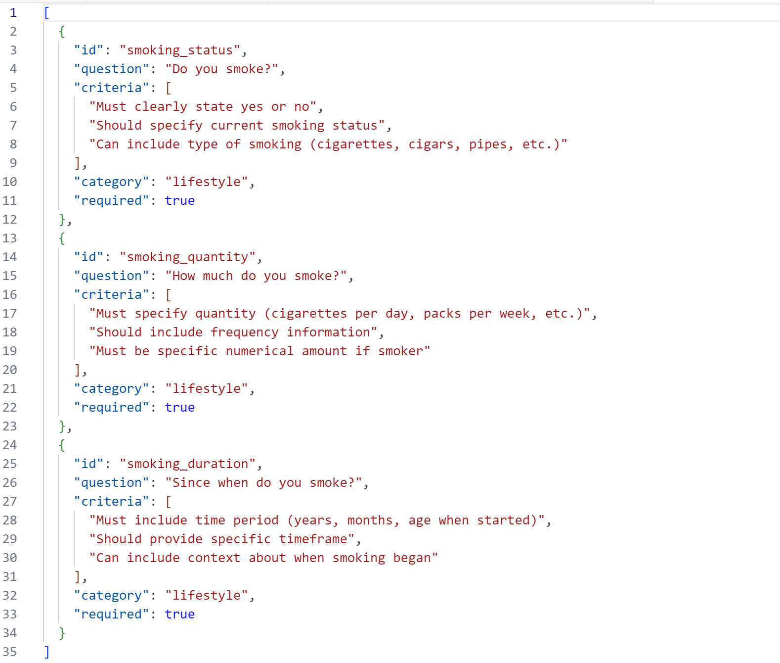
Question Set Example (JSON):

Slide 6
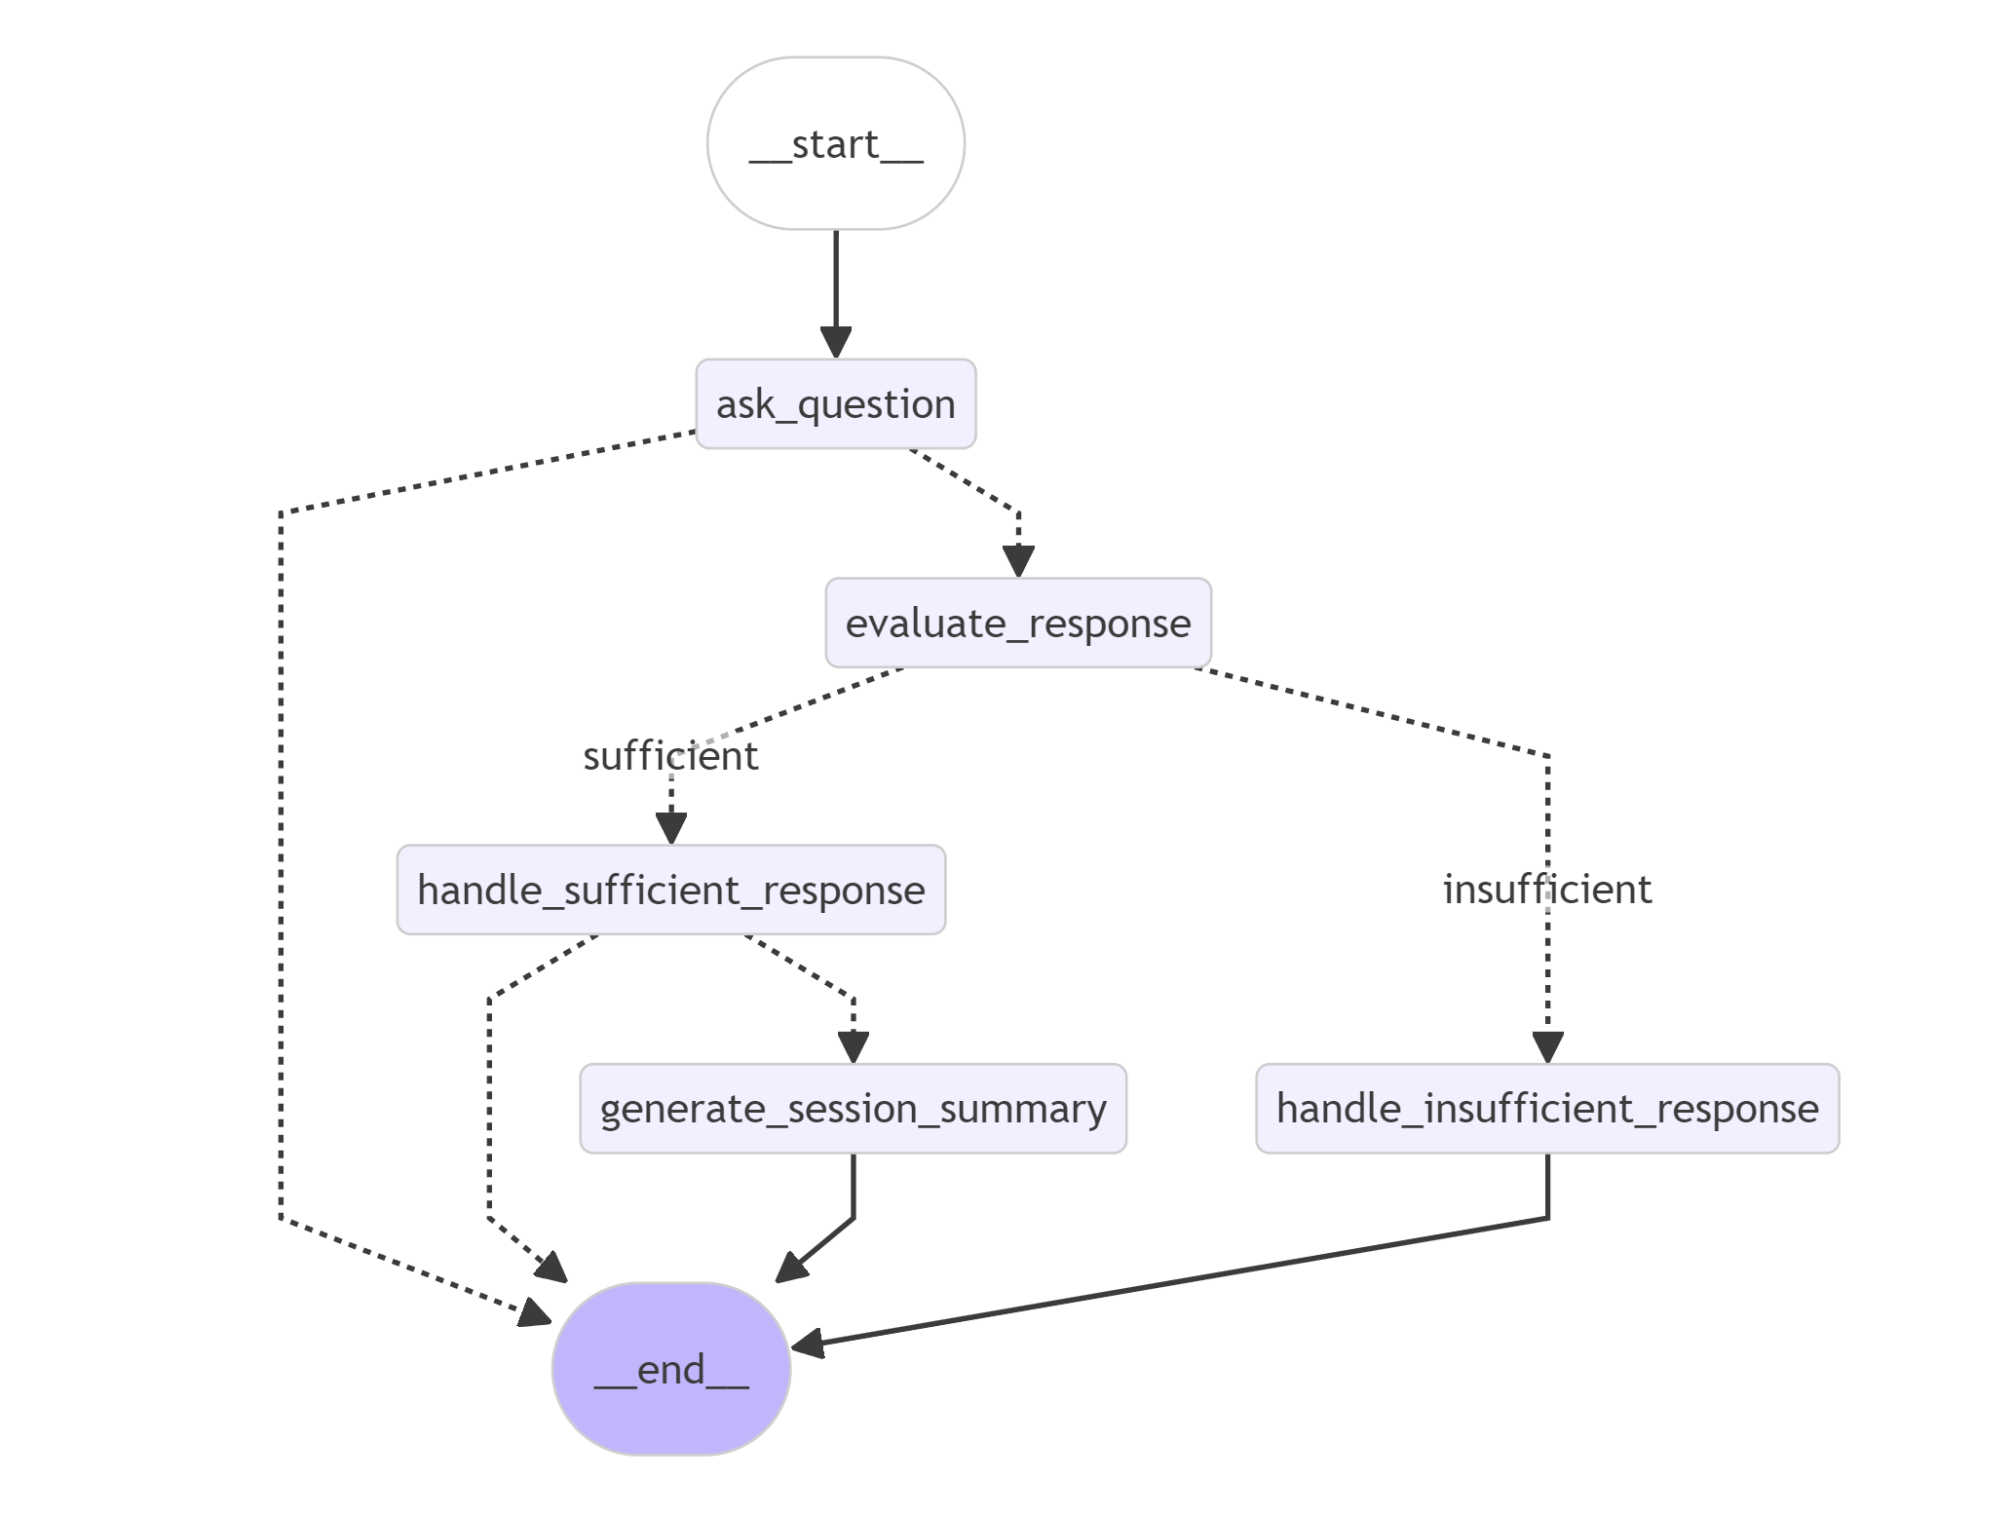
Langgraph Workflow

Slide 7


Stretch Goals
Future Extensions
1
🤖 AI-assisted Question Set Generation
Automatic creation of question catalogs
Adaptation to specialized medical areas
2
🖥️ Local Models
Fully offline-capable version
Privacy-compliant solution for sensitive environments
Integration with local LLM models (Ollama)
3
🎤 Voice Mode
Voice-based interaction
Automatic speech recognition and synthesis
Accessible operation for all patient groups

Slide 8

Thank you for your attention
QuestionnAIre
Revolutionizing patient history taking with AI

